Slide 1
Asynchronous Circuits
M. Balakrishnan
Dept. of Comp. Sci. & Engg.
I.I.T. Delhi

Slide 2
Terminology
Input State
Secondary or
internal state
Secondary or
internal variables
Fundamental mode
x
z
Comb.
Logic
Y
y
Delay

Slide 3
Illustrative Example
Consider a circuit with 2 inputs (x1 and x2) and 1 output (z). The output is “1” only when x1 and x2 are “1” with x1 being “1” first.
x1
x2
z

Slide 4
Total States
x1
x2
z
1
2
3
4
1
4
5
1

Slide 5
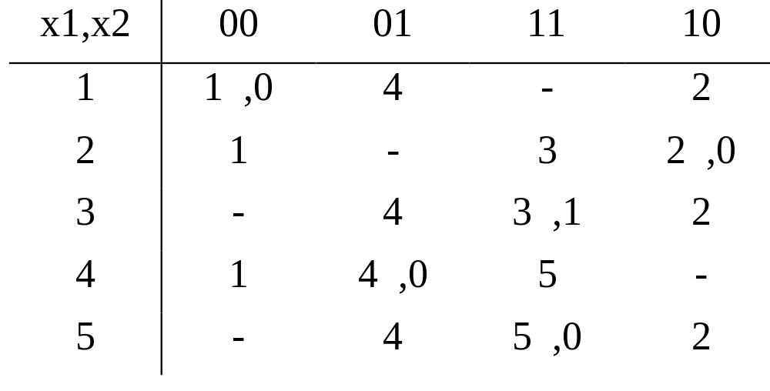
Primitive Flow Table

Slide 6
Merger Graph
Identify compatibility
Identify cliques
A (1,2,3)
B (4,5)
1
4
2
3
5

Slide 7
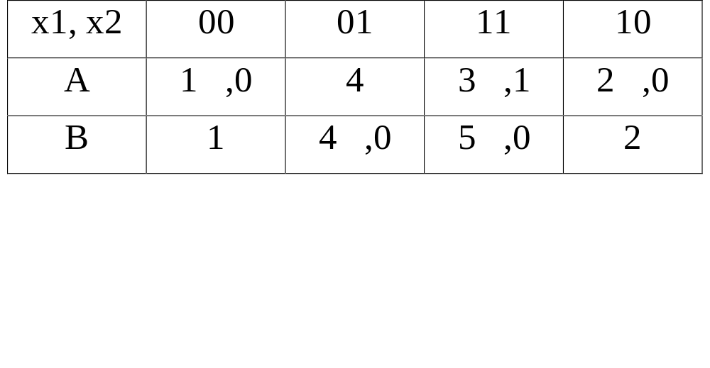
Reduced Flow Table

Slide 8
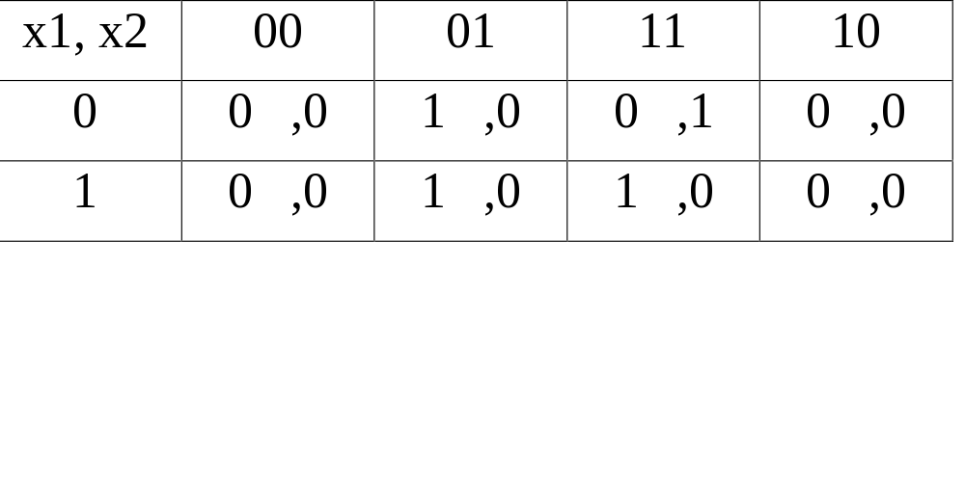
Final State Table
z = y’x1x2
y = x1’x2 + yx2

Slide 9
Asynchronous Circuit
z = y’x1x2
y = x1’x2 + yx2

Slide 10
Asynchronous Sequential Circuit Design
M. Balakrishnan
Dept. of Comp. Sci. & Engg.
I.I.T. Delhi

Slide 11
Another Example
Consider a circuit with 1 input (x ) and 1 output (z). The output should suppress every alternate pulse on the input starting with the first.
x
z

Slide 12
Total States
x
z
1
2
3
4
1

Slide 13
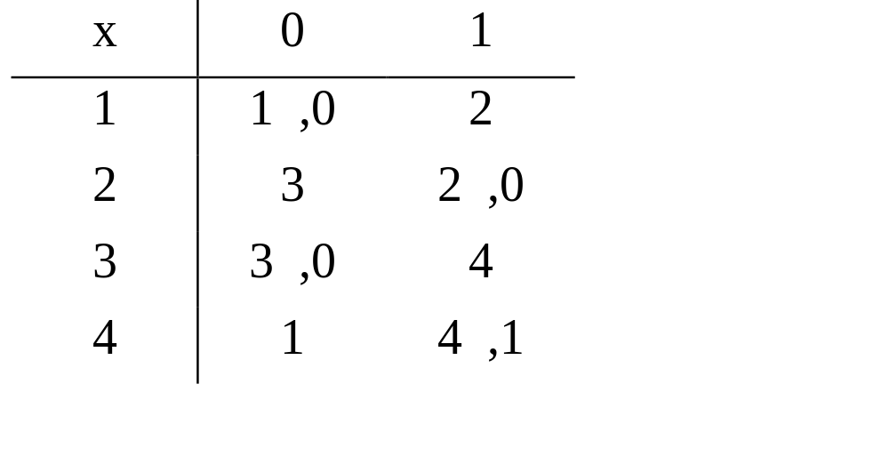
Primitive Flow Table

Slide 14
State Encoding
Let us choose the following encoding
1 : 00
2 : 01
3 : 10
4 : 11

Slide 15
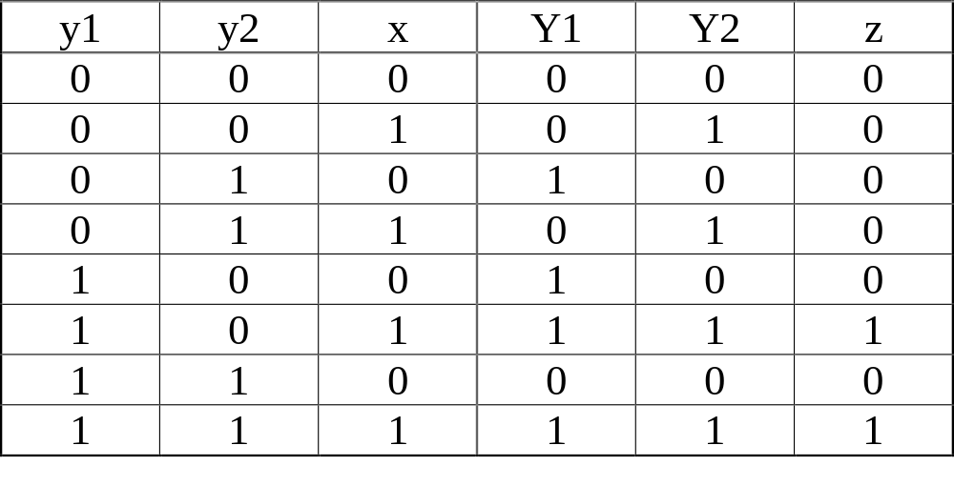
Final State Table

Slide 16
Asynchronous Circuit
z = y1.x
Y1 = y1’.y2.x’ + y1.y2’+y1.x
Y2 = x

Slide 17
Races & Cycles
State assignment of secondary states could result in races and cycles.
Races
  Critical
  Non-critical
Cycles

Slide 18
State Assignment in Asynchronous Circuits
M. Balakrishnan
Dept. of Comp. Sci. & Engg.
I.I.T. Delhi

Slide 19
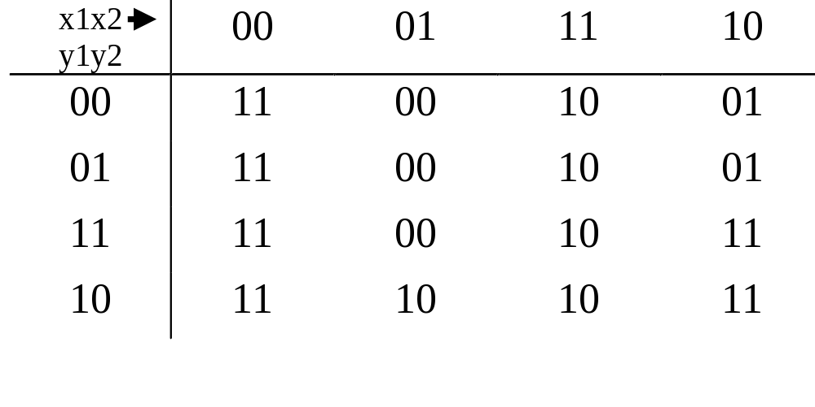
Illustration for Races & Cycles

Slide 20
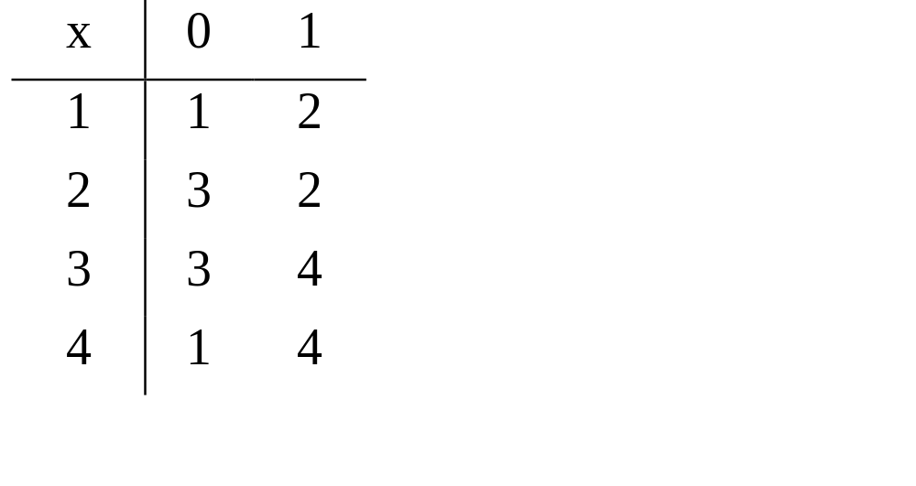
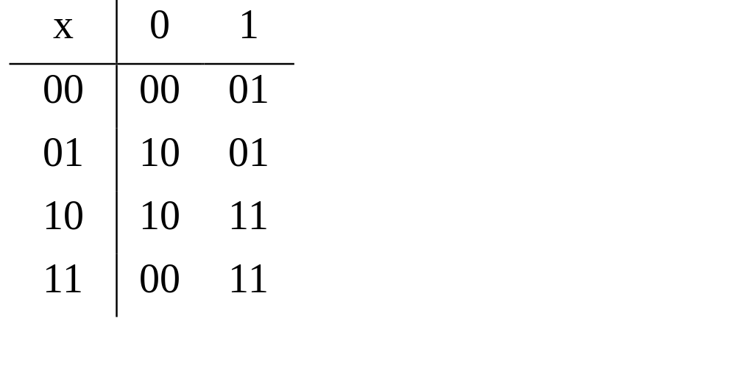
State Assignment

Slide 21
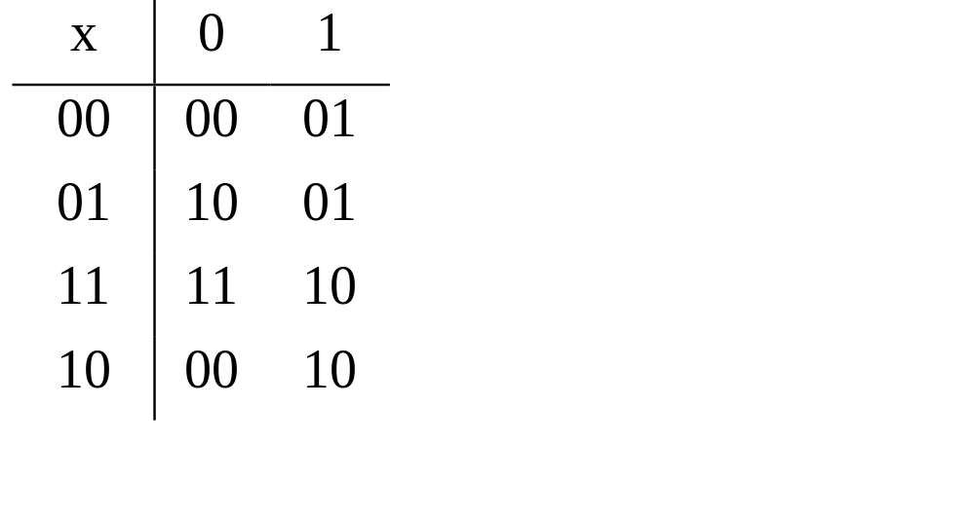
Alternative State Assignment

Slide 22
Transition Graph
Transition Graph is drawn to capture adjacency requirements
1
2
3
4

Slide 23
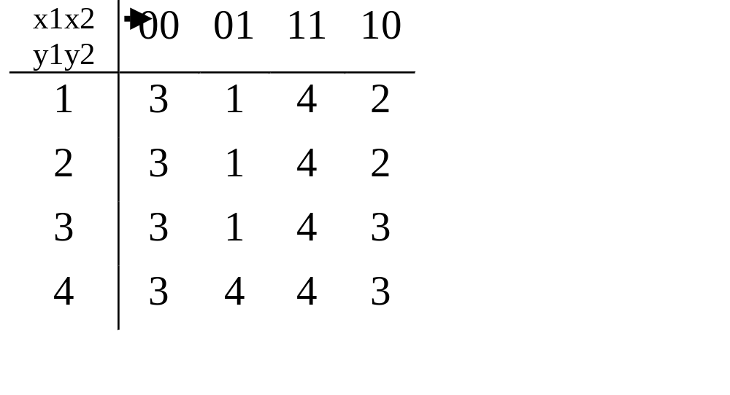
Another Transition Table
(01) (10)
1
2
(01)
(11)
(11)
3
4
(11) (10)

Slide 24
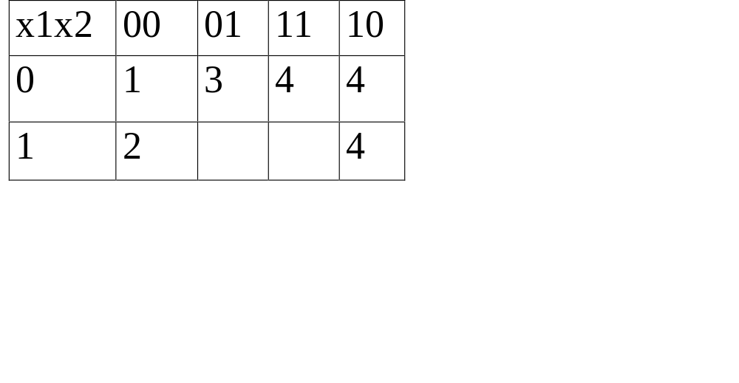
Transition Diagram
(01) (10)
1
2
(11)
3
4
(11) (10)

Slide 25
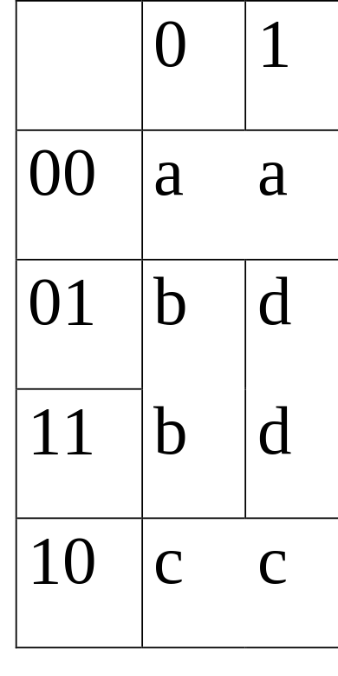
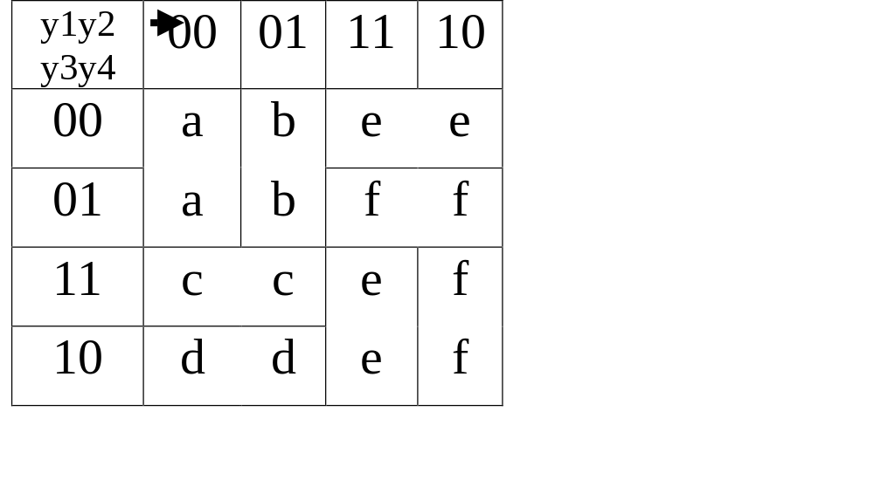
Additional Permanent States

